Slide 1
FACTORS ASSOCIATED WITH EMPLOYEE ATTRITION

Slide 2
KEY OBJECTIVES
The reasons employees are prone to leave Company X.
What type of employee are prone to leave Company X.
Predict the future employee who would tend to leave Company X.

Slide 3
RESULTS FROM ANALYSIS
The determination of the reasons employees are prone to leave Company X was based on the analysis of the Employee who left dataset which contained a sample size of 3571 Employee
MAJOR FACTORS IDENTIFIED
Departmental Factors
Salary Issues
Lack Of Job Growth And Career Advancement (Promotions after working for a number of years)
Low Levels Of Job Satisfaction
MINOR FACTORS IDENTIFIED
Work Accidents
Performance Levels

Slide 4
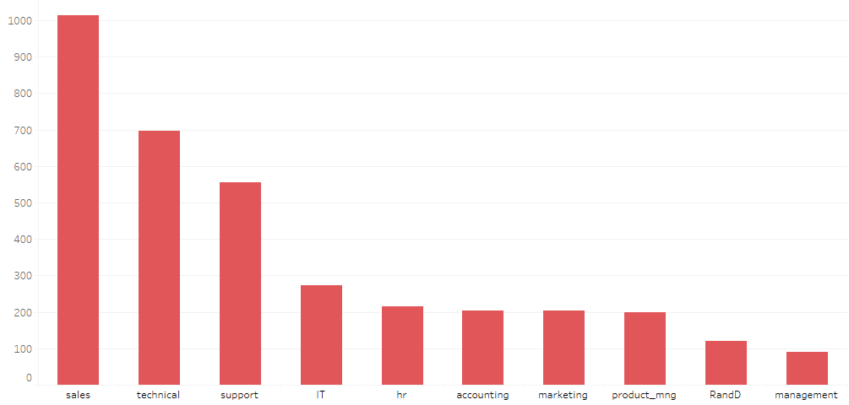
ANALYSIS OF MAJOR FACTORS
Departmental Factors (Breakdown of Employees who left by department)
There are 10 different departments.
28.40% of the employee who left were from the Sales Department
19.52% and 15.54% were from the Technical and Support Department respectively.
These three departments above were grouped and identified as the major departments from which employees are likely to leave (63.46%). The other departments formed the least likely departments with 36.54%

Slide 5
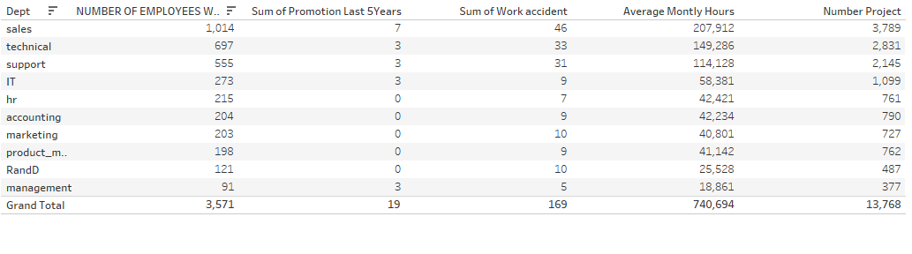
ANALYSIS OF MAJOR FACTORS
Further Analysis of the work characteristics of the 10 Departments
The analysis revealed that the departments classified as Major Departments a had The Most Job Promotions Within The Last 5 Years(this number is relatively insignificant on a whole), The Most Number Of Projects, The Longest Average Working Hours And The Most Number Of Work Accidents

Slide 6
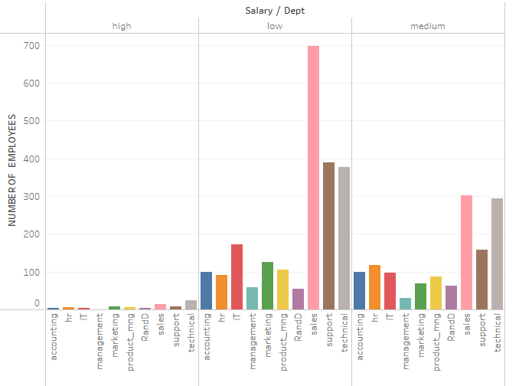
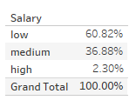
ANALYSIS OF MAJOR FACTORS
Salary Issues (3 classification types for Salaries (Low,Medium,High))
OBSERVATIONS
Most Employees who left fell within the Low salary Classification. This is an indication that lack of proper enumeration was a major factor for Employees leaving Company X.

Slide 7
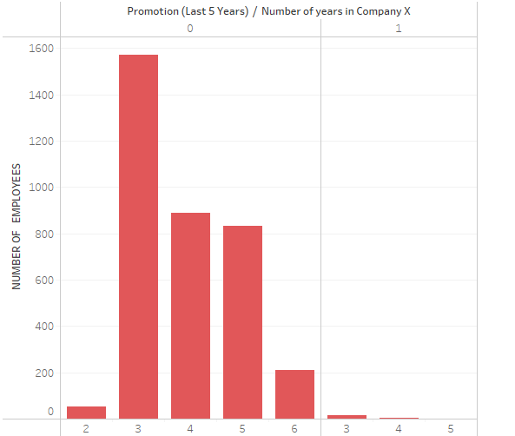
ANALYSIS OF MAJOR FACTORS
Lack Of Job Growth And Career Advancement (Promotions after working for a number of years)
0 | No promotions
1 | Only one promotion
OBSERVATIONS
44.41% of Employees left the company after 3 years of working with company X
The overall lack of promotions within the last 5 years greatly affected employee attrition in Company X
For most Employees ,having room to grow in their career plays an important role in achieving job fulfillment as such the lack of promotions is a major factor for employee attrition

Slide 8
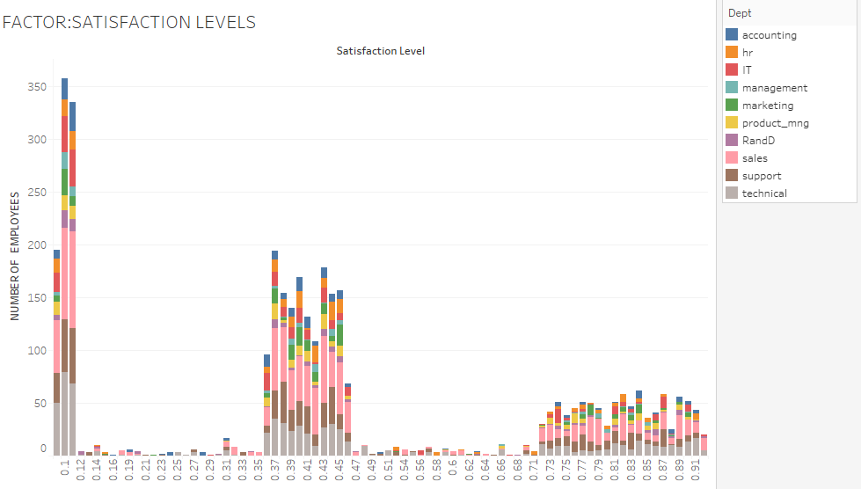
ANALYSIS OF MAJOR FACTORS
Low Levels Of Job Satisfaction ( Average Job Satisfaction level : 0.44)

Slide 9
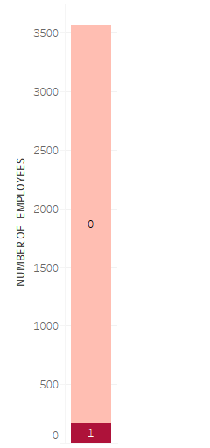
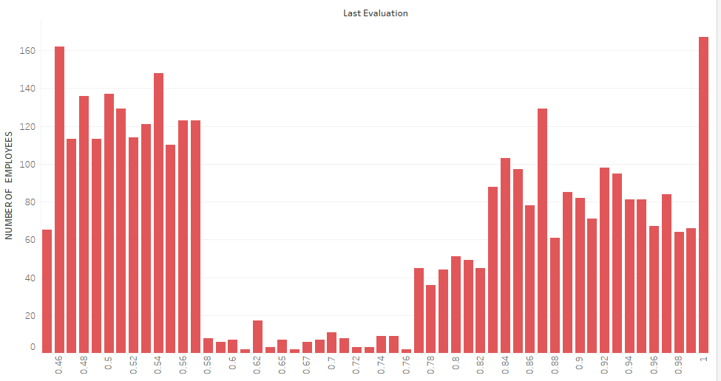
ANALYSIS OF MINOR FACTORS
These two factors below had relatively no significant effect on Employee Attrition
Work Accidents
Performance Levels
0 | No
1 | Yes
The occurrence of work accident didn’t affect an employee leaving.

Slide 10
RESULT FROM ANALYSIS
General Description of the types of Employees prone to leave Company X.
 | CHARACTERISITICS
1 | Belongs to the Sales, Support or Technical Department
2 | Salary Classification is Low
3 | Has an Average Job Satisfaction level of 0.44
4 | No Promotions
5 | Has worked in Company X for 3 years
6 | Has no work accident (the occurrence of work accident didn’t affect an employee leaving)

Slide 11
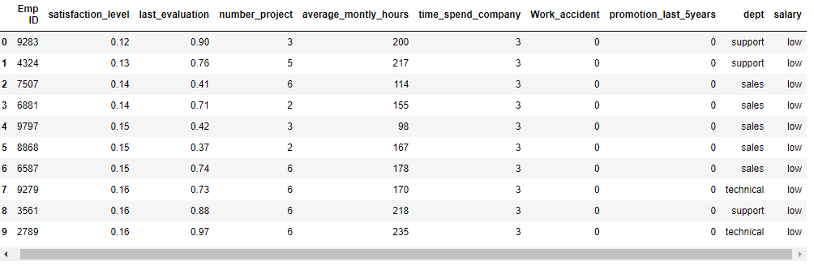
RESULT FROM ANALYSIS
General Description of the types of Employees prone to leave Company X. (table of top 10 employees)

Slide 12
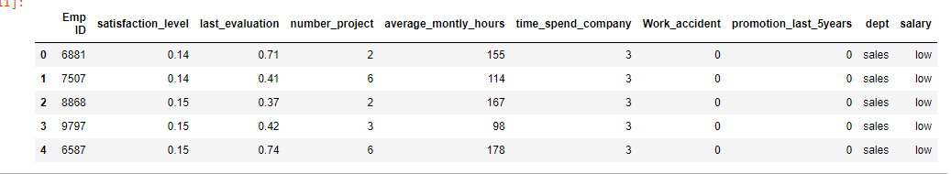
RESULT FROM ANALYSIS
Prediction of the future employee whom is most prone to leave Company X.
Despite the fact that in terms of departments Sales ,Technical and Support were the leading departments employees existed from, the Sales department had the most number of employees (28.40%) leaving as such the most prone to leave is would be in this department and also possesses all the other factors indicated as the General Description of the types of Employees prone to leave Company X.

Slide 13
CONCLUSION
The topmost Employee with ID 6881 is most prone to leave Company X.
DETAILS OF EMPLOYEE WITH ID 6881
Department | Sales
Salary | Low
Job Satisfaction Level | 0.14
Promotions | No Promotions
Years with Company X | 3 years
Work Accident | No work accidents
Last Performance Evaluation | 0.71
Number of Projects | 2
Average Monthly Hours | 155

